Slide 1
Big Mountain Resort Ticket Pricing
Modeling how resort features influence ticket price

Slide 2
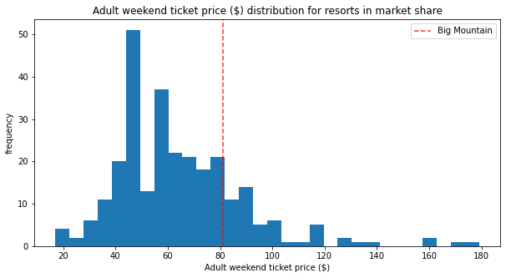
How can Big Mountain Resort price their lift tickets to maximize profits and cover their $1.54M increase in costs by analyzing other resorts of same market share?

Slide 3
Big Mountain’s facilities allow for a $95 +/- $10 ticket price
$0.88 increase would cover the $1.54M chairlift cost increase
Modest increase in vertical drop by adding a chairlift could allow $1.99 further increase
1 run could be closed with no negative impact on price
Up to 5 run closures possible with minimal negative impact
Key Findings
and
Recommendations:

Slide 4
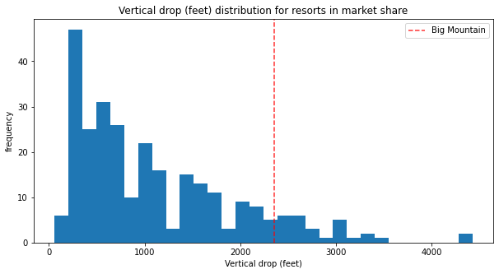
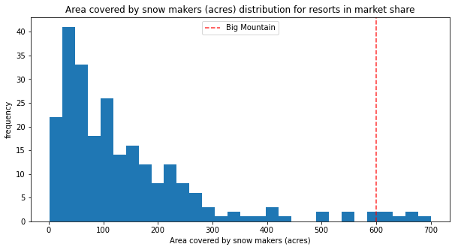
Most Influential Pricing Features
Vertical drop
Snow making area
Total chairs
Fast quad chairs
Number of runs
Longest run
trams
Area of skiable terrain

Slide 5
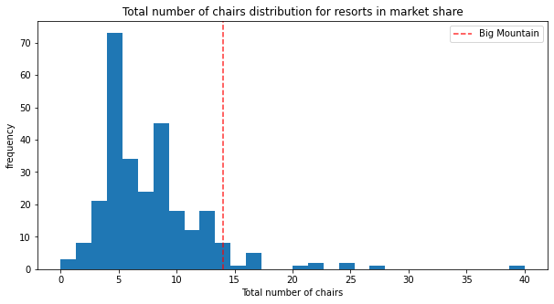
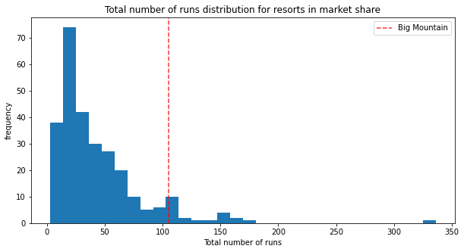
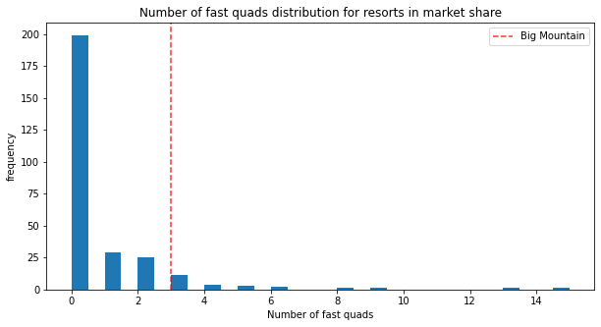
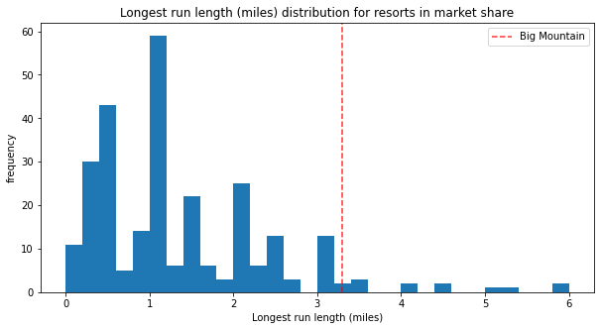

Slide 6
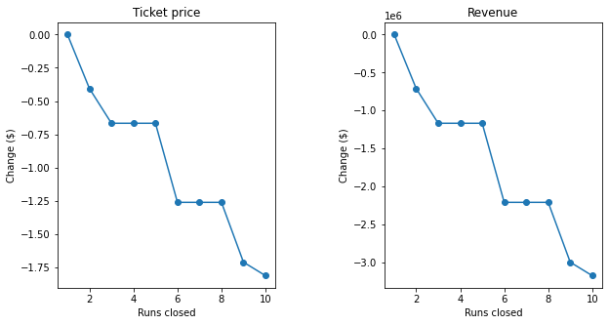
Run Closures vs Price/Revenue

Slide 7
Conclusion
Big Mountain Resort should charge at least $0.88 more per ticket to cover their recent chair addition
Could likely increase the price by $10 per ticket to increase profitability or if needed to cover future expenses
Increasing vertical drop 150 feet by adding a chairlift would be the most beneficial of all proposed mountain changes
If closing runs is necessary to reduce operating costs, it should be done 1 at a time with no more than 5 closures

